Slide 1
North Carolina
Travel & Tourism Coalition
Board Meeting
August 22, 2022

Slide 2
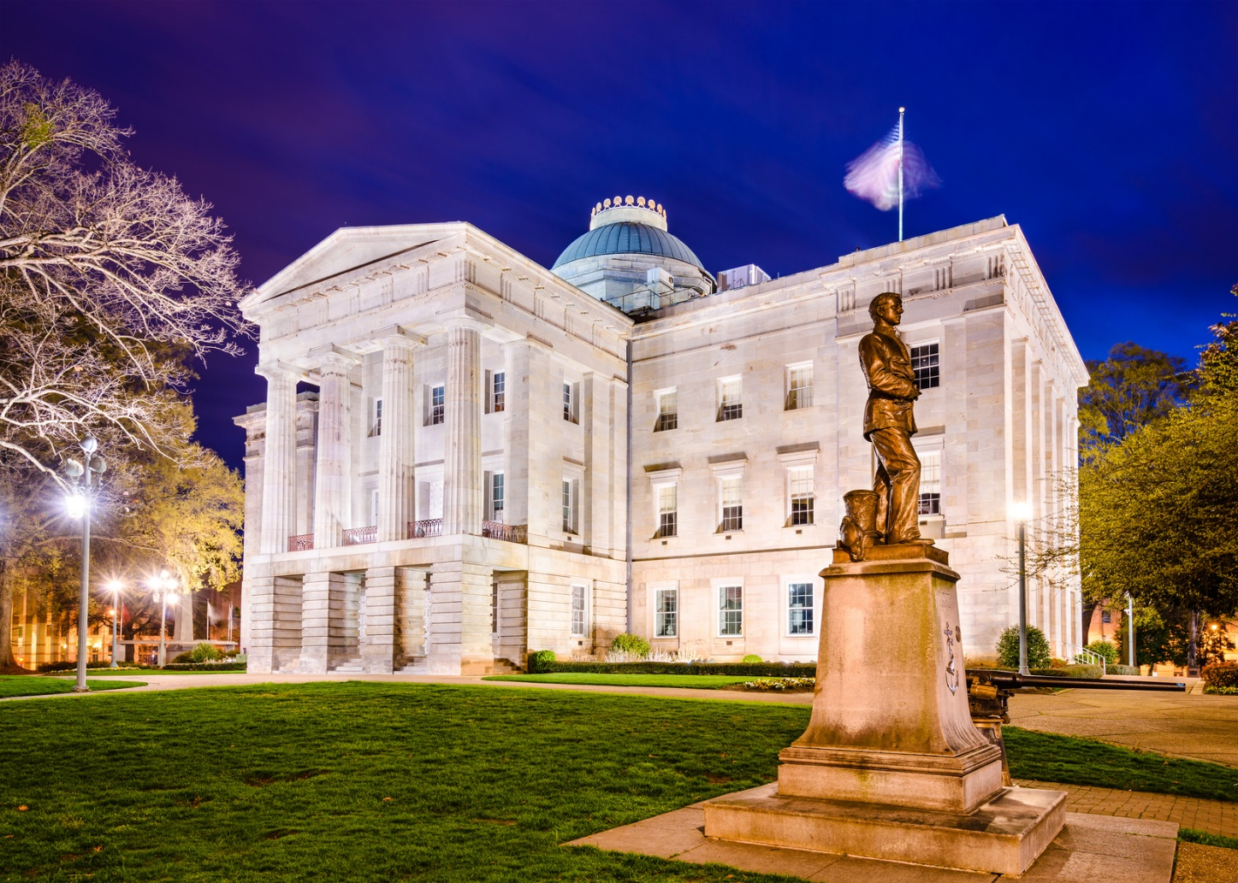
Overview
2022 Short Session Recap
  Budget – adjustments to funding
  Occupancy Taxes
  School Calendar
  Gaming/Sports/Ticket Issues
  Local Non-Discrimination Ordinances
General Election Preview
Old Business
New Business

Slide 3
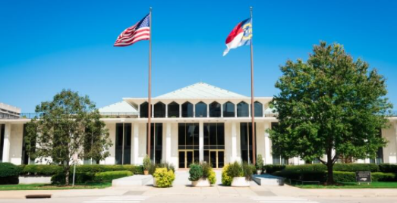
2022 Short Session

Slide 4
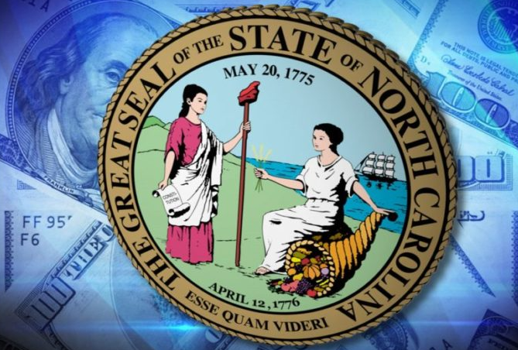
Budget
  State funds ($20M) replace the federal funds from the 2021 budget.
  This adjustment was needed to avoid further delays in EDPNC tourism marketing caused by compliance with federal ARPA funding regulations.

Slide 5
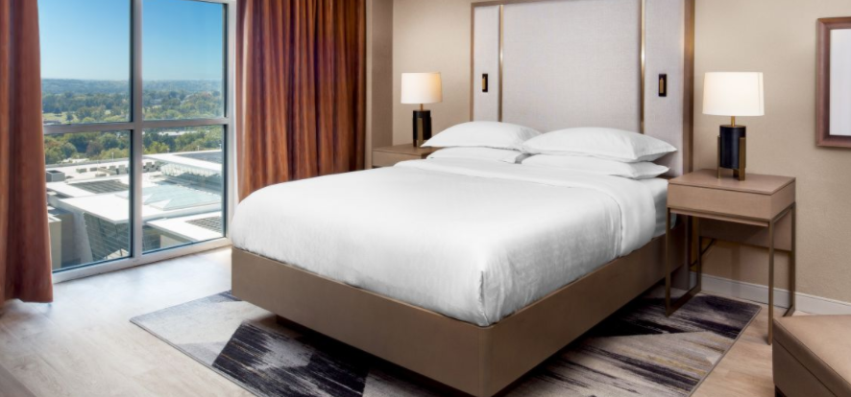
Occupancy Taxes
  HB 1057 – Mitchell/Hickory-Conover/Buncombe OT Changes
    Mitchell County OT to allow a community college foundation-owned hotel to collect taxes
    Hickory-Conover OT would extend the law regarding convention center funding
    Buncombe County OT is adjusted based on a local compromise that is consistent with the House guidelines
Notes:
OT committee: Warren, Carney, Sauls, Everitt, Zenger

Slide 6
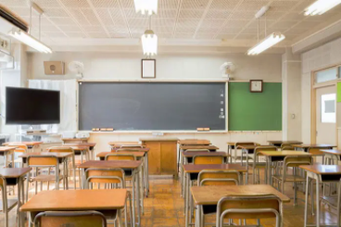
School Calendar
  Multiple bills passed the House
  Senate support for current law, no movement
  Developed grassroots plan and creating new collateral to highlight the importance of the law
  Some school districts actively breaking the law (Rutherford, Cleveland, Gaston)

Slide 7

Gaming/Sports/Ticketing Regulatory Issues
  SB 688 – Sports Wagering
    House took up substitute bill, SB 38, by a vote of 51-50
    SB 688 narrowly failed by a vote of 49-52
    Future of legislation unclear

Slide 8
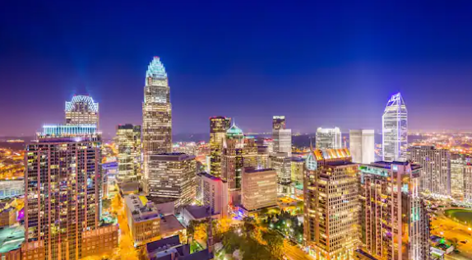
Weaponization of Tourism
  Monitoring activity around hot button issues (abortion, LGBTQ, gun laws, etc.) that could impact tourism
  Will continue to work with the business community to advocate for industry and communicate harm from travel bans

Slide 9
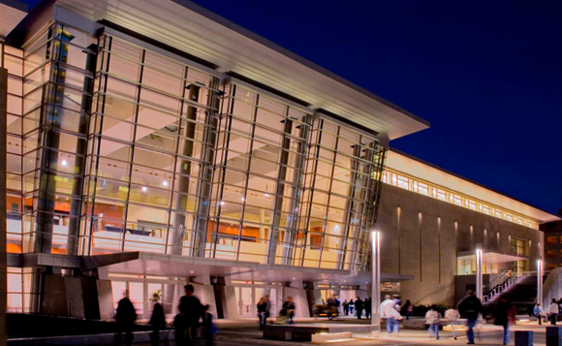
Reopening Discussion
  Member Discussion
  Emergency Declaration expired August 15th
  Budget included provision (effective 1/1/23) to limit gubernatorial emergency powers

Slide 10
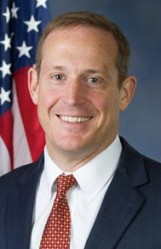
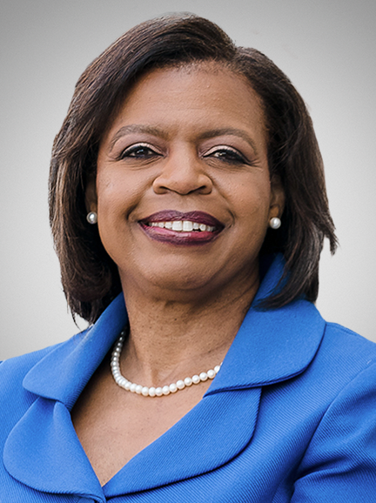
U.S. Senate Race – N.C.
  N.C. could decide control of U.S. Senate (50/50 tie).
  2020 U.S. Senate race in N.C. was most expensive in American history.
  The Contenders:
    GOP: Ted Budd
    Democratic: Cheri Beasley

Slide 11
Congressional Races
  U.S. HD 1 (Northeast NC Counties)
    With Congressman G.K. Butterfield retiring, NC Sen. Don Davis (D) bested former NC Sen. Erica Smith (D).
  U.S. HD 4 (Durham, Orange, Alamance, Person, Granville)
    NC Sen. Valerie Foushee (D-Orange), American Idol singer Clay Aiken and Durham County Commissioner Nida Allam ran to replace retiring Congressman David Price (D). Valerie Foushee (D) won the race with 46% of the vote.
  U.S. HD 11 (Western NC Counties)
    Controversial Congressman Madison Cawthorn (R) sought to serve a second term, but was defeated by NC Sen. Chuck Edwards (R-Henderson).
  U.S. HD 13 (Western Wake, Harnett, Johnston, Wayne)
    Newly drawn HD 13 had packed primaries for both Republicans and Democrats. NC Sen. Wiley Nickel (D) will face off against NCSU football player Bo Hines (R) in the Fall.

Slide 12
NC Legislative Races
  Several members double-bunked
    Rep. Ben Moss (R-Richmond) beat Rep. Jamie Boles (R-Moore)
    Rep. Jake Johnson (R-Polk) beat Rep. David Rogers (R-Rutherfordton)
    Sen. Norm Sanderson (R) beat Sen. Bob Steinburg (R)
    Sen. Ralph Hise (R) beat Sen. Deanna Ballard (R) – SD 47
  Rep. Pat Hurley (R-Randolph)upset by realtor & school board member Brian Biggs
  Former Rep. Tricia Cotham likely to return after winning the Democratic primary in Charlotte
    Occupancy tax subcommittee member

Slide 13
NC Legislative Races
  Key retirement for the tourism industry
    Rep. Pat McElraft (R-Carteret)
  Key House members running for the Senate in the Fall
    Rep. Tim Moffitt (R) – Henderson, Polk, Rutherford
    Rep. Bobby Hanig (R) – Currituck, Tyrrell, other NE Counties
    Rep. Gale Adcock (D) – Wake
    Rep. Graig Meyer (D) – Orange
    Rep. Rachel Hunt (D) – Mecklenburg

Slide 14
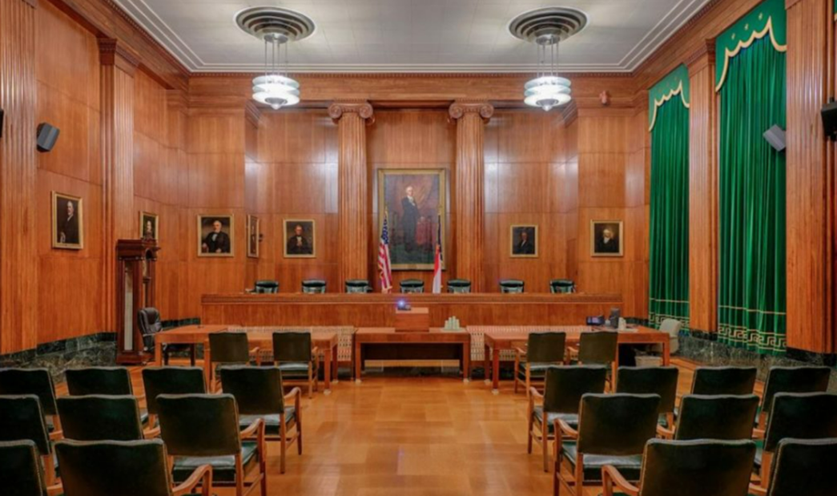
N.C. Supreme Court
  Two of the seven seats are up in 2022
    Lucy Inman (D) vs. Richard Dietz (R)
    Sam Ervin (D) vs. Trey Allen (R)

Slide 15
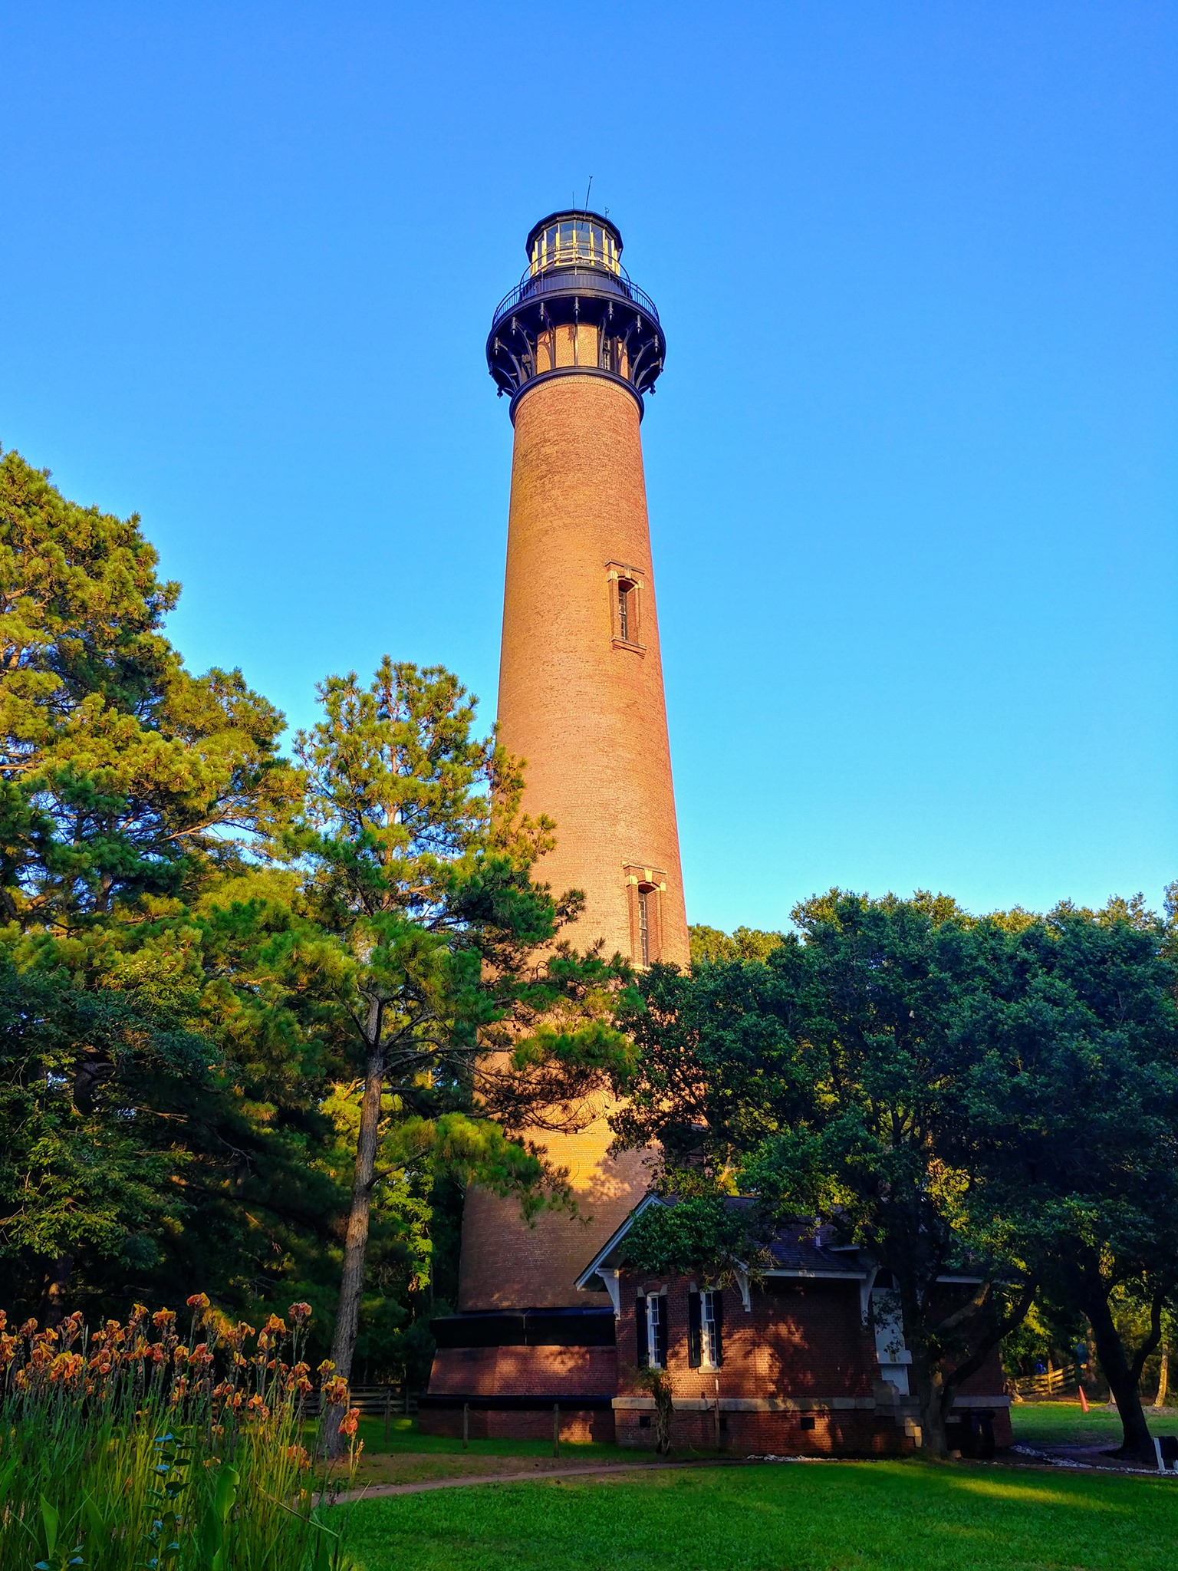
Old Business
  Corolla Civic Association Litigation
  Workforce Subcommittee – monitoring national trends
  Occupancy Tax Subcommittee – quarterly meetings to discuss policies

Slide 16

New Business

Slide 17
B. Davis Horne Jr., Esq.
Dana E. Simpson, Esq.
Kara G. Weishaar
Smith Anderson Blount Dorsett Mitchell & Jernigan, LLP
Post Office Box 2611
Raleigh, North Carolina 27602-2611
919.821.1220

