Slide 1
North Carolina
Vacation Rental Managers Association
December 6, 2022

Slide 2
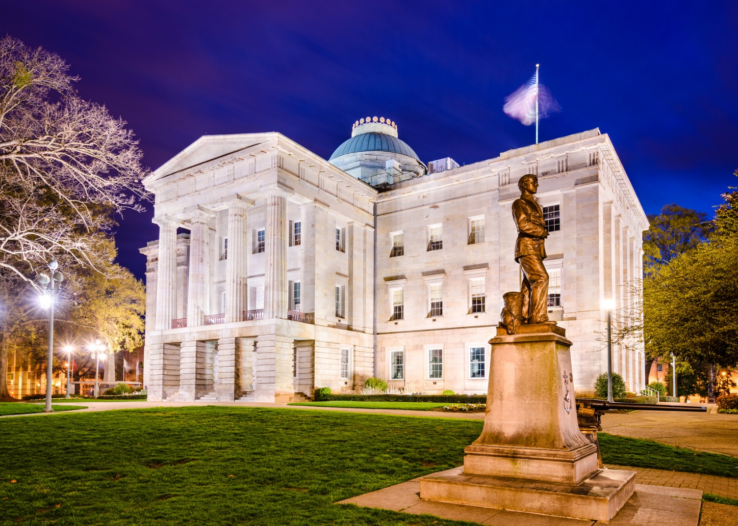
Overview
General Election Recap
2023 Legislative Session Preview
  Budget
  School Calendar
  Gaming/Sports/Ticket Issues
  Local Non-Discrimination Ordinances
  Occupancy Taxes

Slide 3
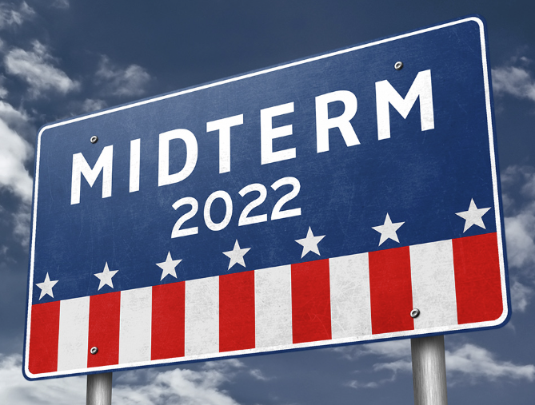
General Election Recap
  More than 3.7 million North Carolinians cast their ballots in this year’s midterm elections.
  The pivotal races included:
    A highly competitive bid for U.S. Senate
    Key congressional races
    State House and Senate seats
    Closely watched judicial races

Slide 4
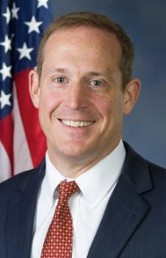
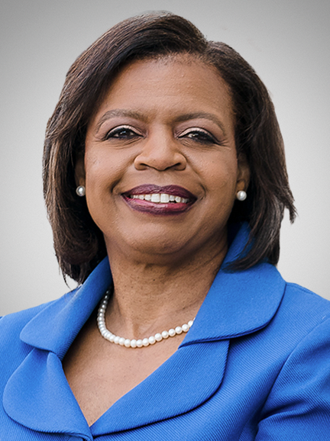
U.S. Senate Race – N.C.
  Republican Ted Budd prevailed over Democrat Cheri Beasley (51% to 47%)
  Democrats maintain control of U.S. Senate (50-49); Georgia runoff will not impact

Slide 5
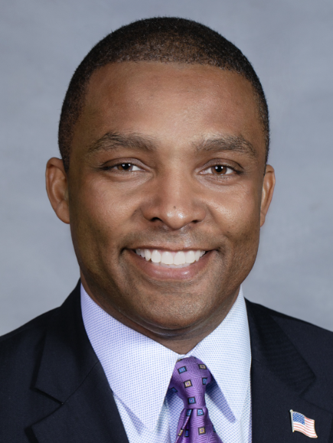
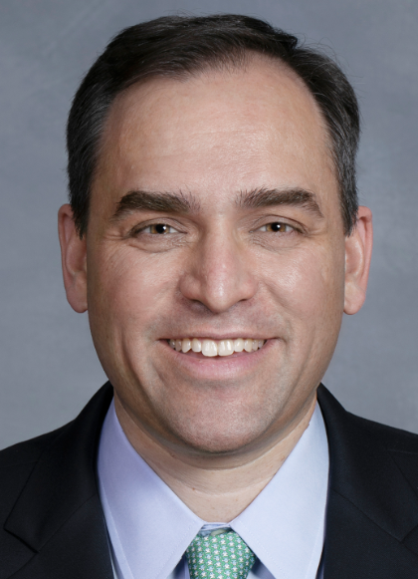
Congressional Races
  NC gained a congressional seat and the election yielded seven democrats and seven republicans for the NC delegation
  Redistricting expected in 2023
  U.S. HD 1 (Northeast NC Counties)
    With Congressman G.K. Butterfield retiring, NC Sen. Don Davis (D) will represent HD 1.
  U.S. HD 13 (Western Wake, Harnett, Johnston, Wayne)
    Newly drawn HD 13 had packed primaries for both Republicans and Democrats. NC Sen. Wiley Nickel (D) bested NCSU football player Bo Hines (R) in this toss up race.
Notes:
As of 11/13: R’s 211 and D’s 206 (need 218 for control)
18 races still outstanding

Slide 6
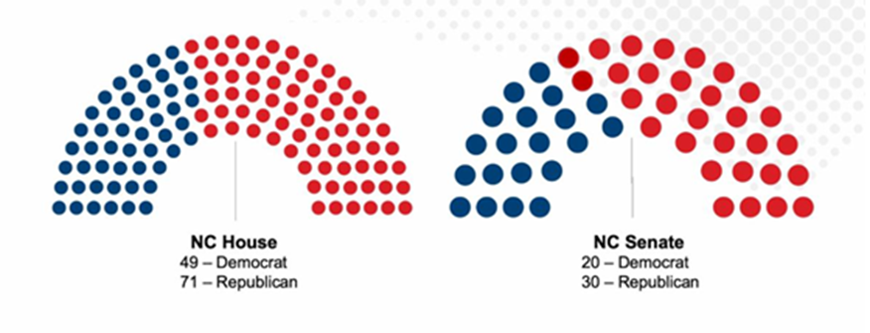
NC Legislative Races
  In the House, Republicans fell one seat short of a supermajority with 71 R’s and 49 D’s.
  The Senate Republicans added two seats resulting in 30 R’s and 20 D’s, giving that chamber a veto-proof supermajority. Sens. Berger & Rabon remain in leadership.
  Speaker Moore already working to build alliances with select House Democrats.

Slide 7
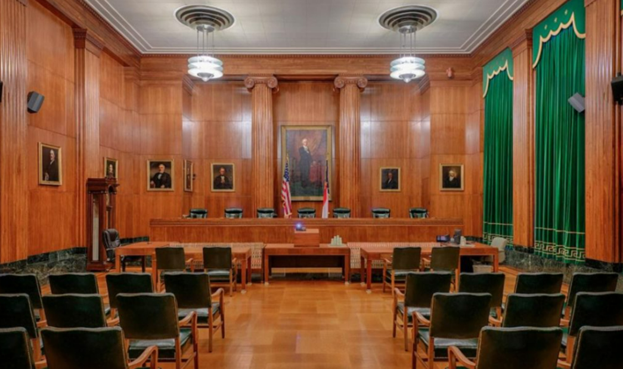
N.C. Supreme Court
  Two of the seven seats were up in 2022
  Both Republicans prevailed:
    Richard Dietz (R)
    Trey Allen (R)
  Court shifts to a 5-2 Republican majority
    Due to staggered terms, Republicans will have a majority on the Court until at least 2028

Slide 8
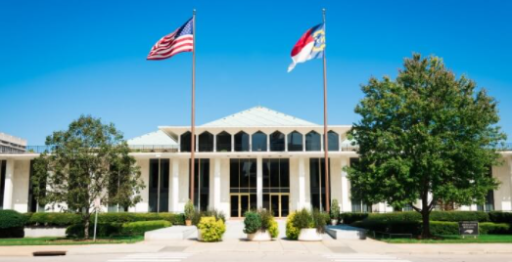
2023 Legislative Session

Slide 9
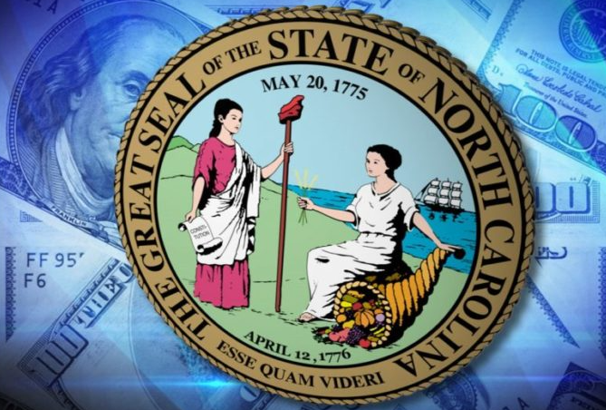
Budget
  Legislature to work on two-year budget.
  Other policy items may be included to garner House Democratic support
    Medicaid Expansion?

Slide 10
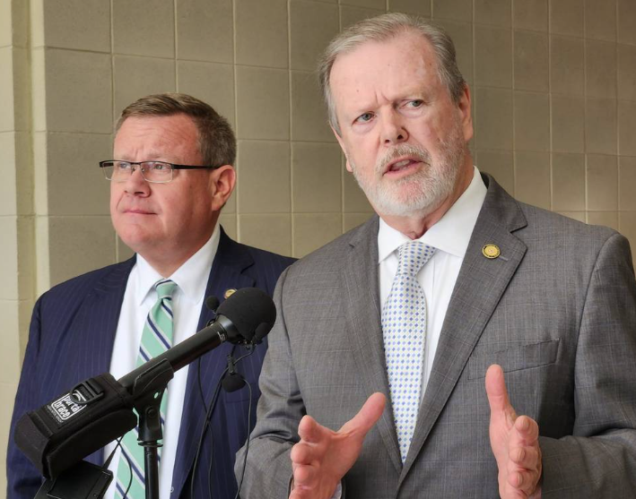
Tax Policy
  GOP legislative leaders focused on additional tax reductions.
    Senator Berger mentioned personal income tax cuts in post-election press conference.

Slide 11

School Calendar
  Litigation – strategy & recommendations
    Industry letter to violating districts
    Seeking plaintiff(s) for litigation
    Legislative enforcement mechanism (funding cut?) for compliance

Slide 12

Gaming/Sports/Ticketing Regulatory Issues
  SB 688 – Sports Wagering
    Legislative leadership announced no additional votes in 2022
    Future of legislation in 2023 unclear

Slide 13

Weaponization of Tourism
  Monitoring activity around hot button issues (abortion, LGBTQ, gun laws, etc.) that could impact tourism
  Will continue to work with the business community to advocate for industry and communicate harm from travel bans

Slide 14
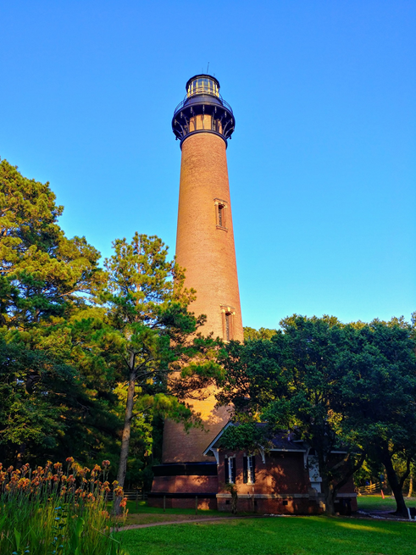
Occupancy Taxes
  Corolla Civic Association Litigation
    Industry Amicus Brief Filed from NCTTC, NCRLA, NCVRMA, NCHA
Notes:
OT committee: Warren, Carney, Sauls, Everitt, Zenger

Slide 15
Kara G. Weishaar
Smith Anderson Blount Dorsett Mitchell & Jernigan, LLP
Post Office Box 2611
Raleigh, North Carolina 27602-2611
919.821.1220

