Slide 1
OVERVIEW
Visitor Mindset – Travel Trends
Vacation Rental Market Data
Visit NC Marketing

Slide 2
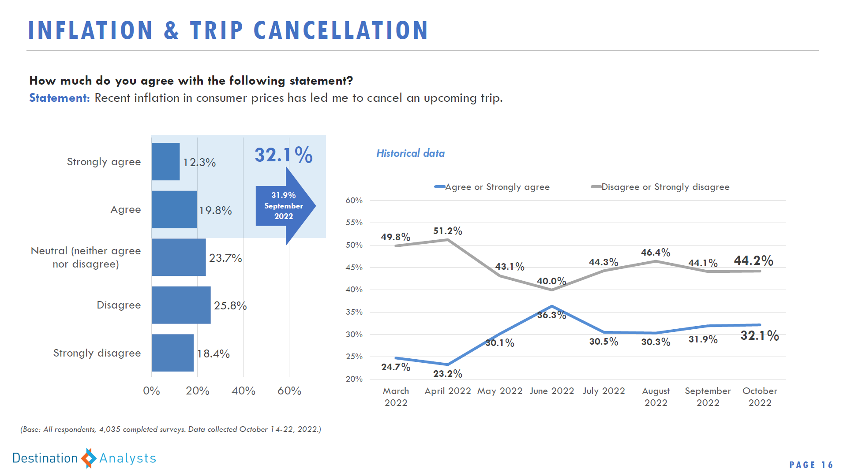

Slide 3
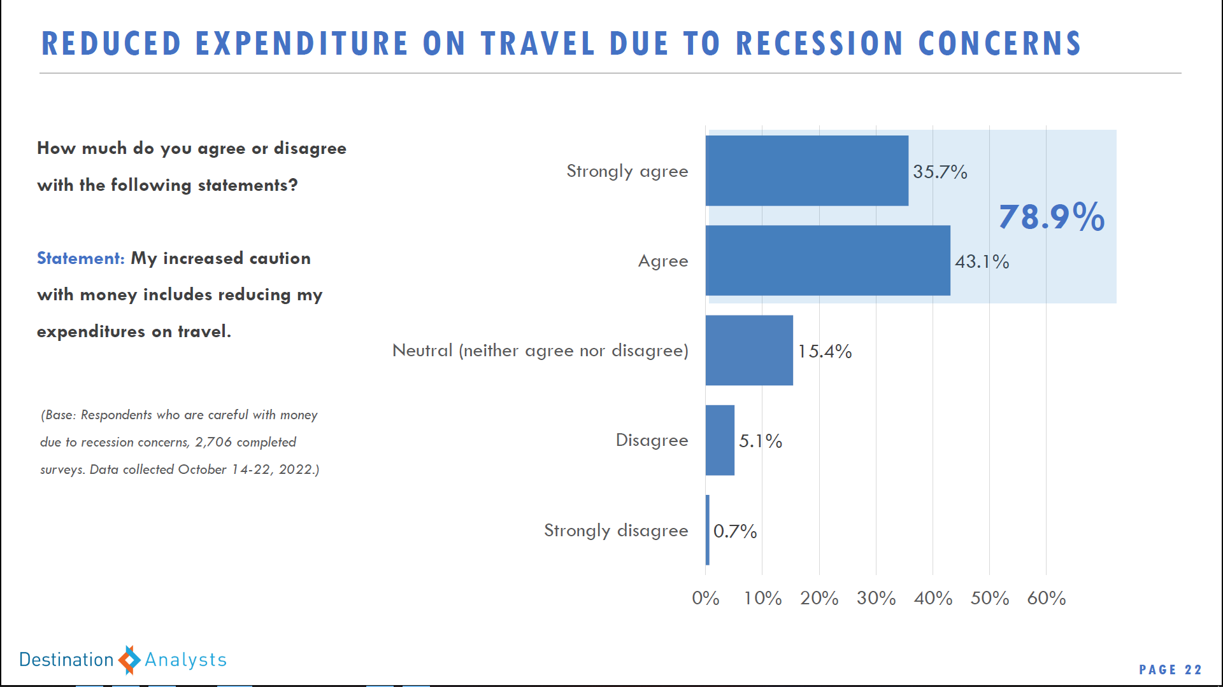

Slide 4
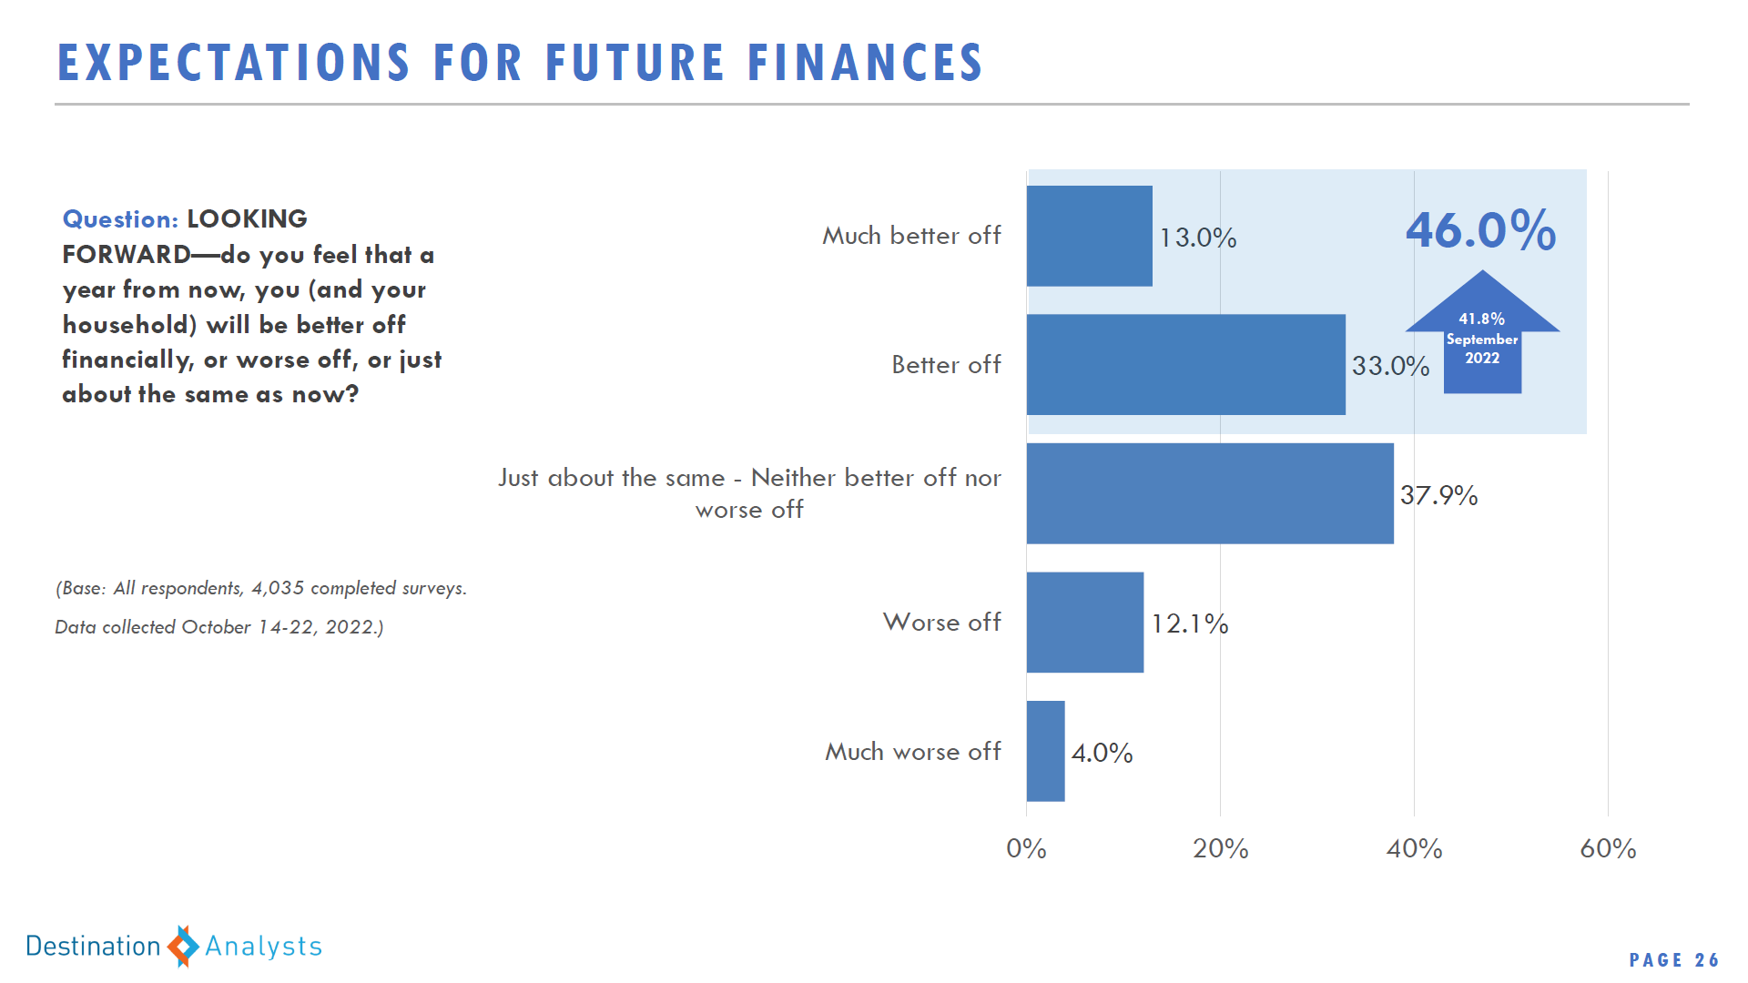

Slide 5
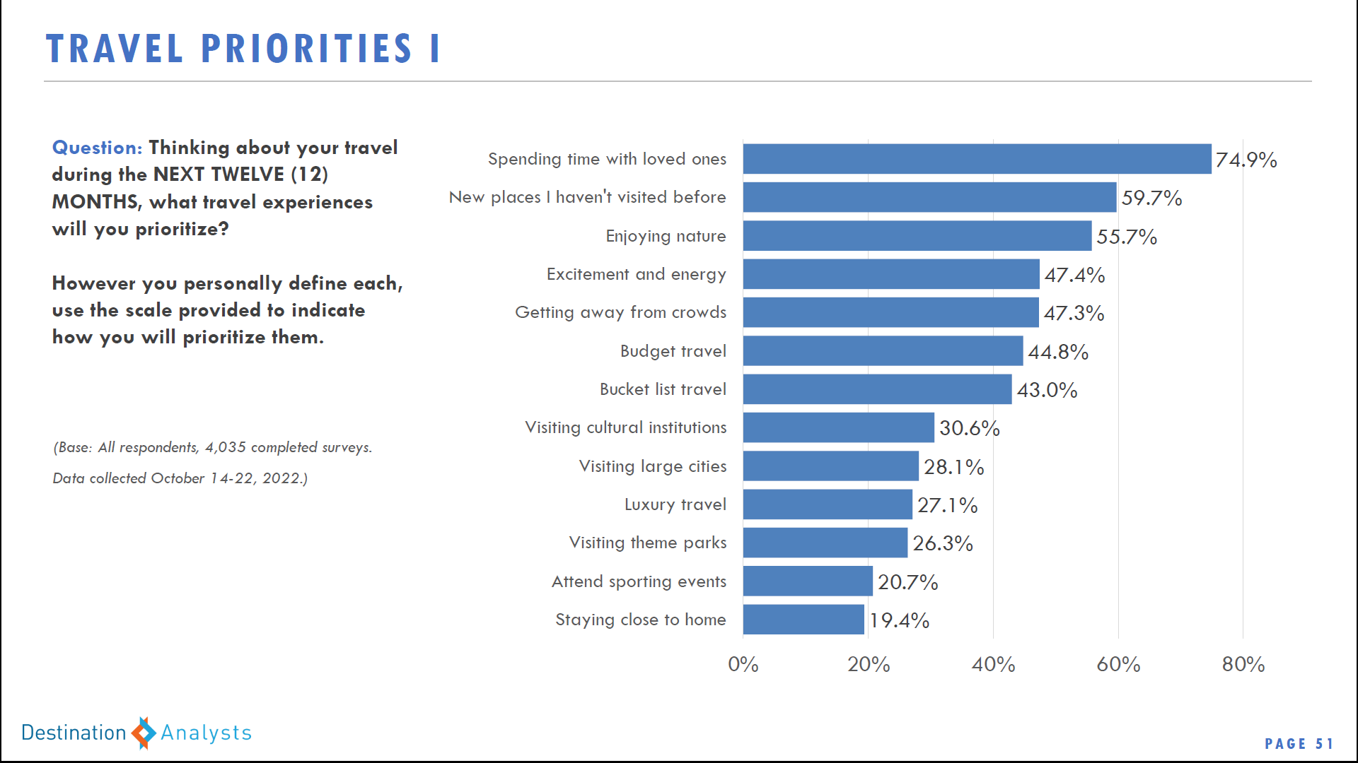

Slide 6
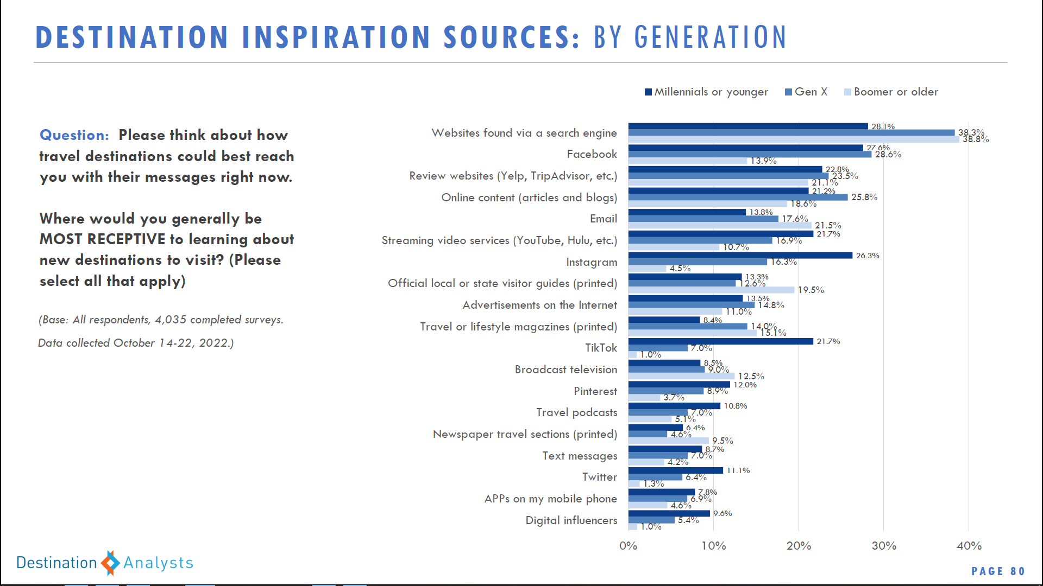

Slide 7
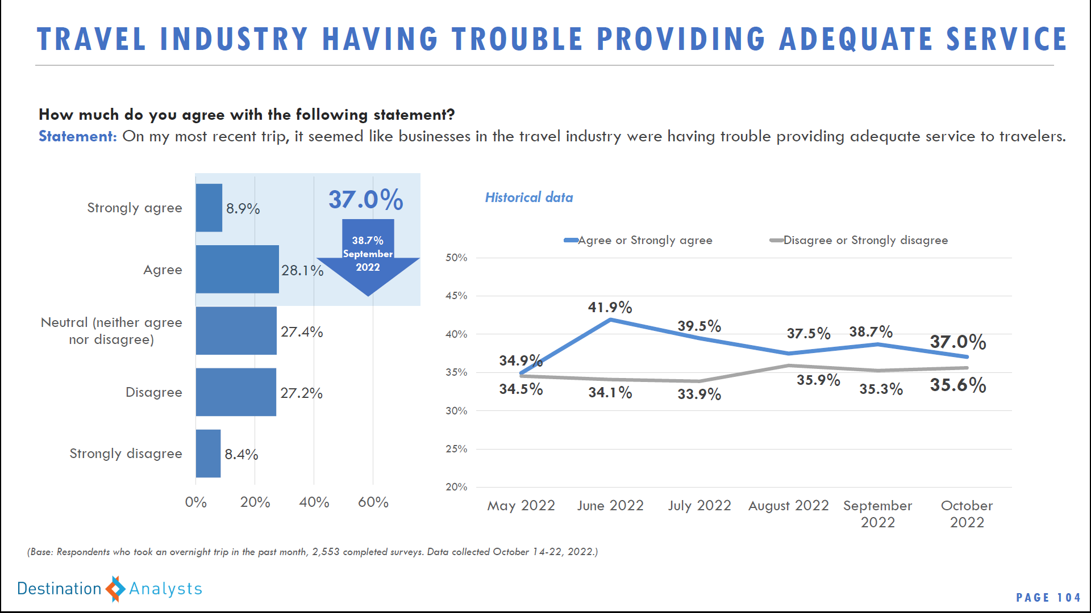

Slide 8
NC tourism Market data

Slide 9
Lodging in North Carolina
Lodging in North Carolina is a $6.4 billion sector (Tourism Economics, 2022)
After a 24% drop in spending in lodging in 2020, revenues rebounded in 2021 to a record $6.4 billion
Notes:
In 2021, visitors to and within North Carolina spent $6.4 billion in lodging. This was a record year, increasing 50% after a decrease of 24% in 2020. Part of the increase in revenues are a result of increased rates, which were up depending on the type of property between 5-16%, but the increase was more affected by increased demand for lodging. In 2021, overnight visitation in paid lodging increased 44% from 2020.

Slide 10
Lodging Supply (2021)
 | NC Commercial Lodging (STR) | Airbnb/HomeAway entire home rentals (AirDNA) | Vacation Rentals (KeyData)
Supply (properties) | 1,906 | 41,218 | 8,828
Supply (rooms) | 165,094
Supply (room nights) | 60,259,366 | 32,644,387 | 3,222,232
*Note that some overlap exists between AirDNA and KeyData as some traditional rentals are also sold on shared platforms.
**Also note that no data exists for other lodging such as campgrounds, traditional B&Bs, etc.
Notes:
Commercial hotels/motels make up the majority of room nights available each year in NC for lodging, followed by shared home rentals and traditional rentals. There is some overlap exists between AirDNA and KeyData as some traditional rentals are also sold on shared platforms. While we do not have data on other types of lodging such as campgrounds or traditional B&Bs, it is certain that these three types of lodging make up the majority of accommodations in the state.

Slide 11
Historical Trend of NC Lodging – Commercial hotels vs rentals (shared economy & traditional)
*Note that some overlap exists between AirDNA and KeyData as some traditional rentals are also sold on shared platforms.
**Also note that no data exists for other lodging such as campgrounds, traditional B&Bs, etc.
***Traditional rental data based on properties for which KeyData Dashboard has data.
Notes:
While we know there is some overlap due to some traditional properties listed on shared platforms, if we look at just the revenues generated from these three categories of rentals, you can see that the proportion of revenues generated by hotels/motels has really shifted downwards and while exasperated by the pandemic, was already shifting somewhat prior to 2020.
The proportion of revenues for hotels decreased 41% from 2016 to 2021 while the proportion of revenues for shared economy rentals increased 91%. The proportion of revenues for traditional, managed rentals has increased 30% in the same timeframe.

Slide 12
January – October 2022: North Carolina Lodging Data
 | NC Commercial Lodging | Airbnb/HomeAway entire home rentals (AirDNA) | Vacation Rentals (KeyData)
Occupancy | Up 8.5% | Down 6.2% | Down 14.7%
Room Rates | Up 14.4% | Up 8.7% | Up 13.1%
RevPAR | Up 24.1% | Up 1.0% | Up 2.6%
Revenues | Up 25.4% | Up 31.9% | Up 7.6%
Demand | Up 9.6% | Up 23.9% | Down 7.5%
Supply | Up 1.0% | Up 32.0% | Up 7.8%
Sources: STR, AirDNA, KeyData, 2022
Notes:
Lodging Analysis – YTD 2022
While hotel business and shared economy lodging are continuing to show improvements in 2022, in both demand and revenues, traditional home rentals are down in the first ten months of 2022 from last year.
Commercial room demand through the first ten months is at nearly record levels, just down 0.5% from the record demand set in 2019 and up nearly 10% from last year. Revenues are at record levels for commercial lodging year-to-date, owing more of that to increased rates than demand.

Slide 13
NC Lodging Demand Recovery – Compared to 2019
Notes:
Lodging Recovery – vs. 2019
When comparing lodging demand data monthly to 2019 data you can see that statewide nights sold in shared economy entire home continue to outpace 2019 bookings, as do traditional rentals. Commercial hotel room nights booked are still in recovery mode, with April, June, July, August, September and October each topping previous demand records set in 2019.

Slide 14
Consumer marketing

Slide 15


2021: Recovery Year for NC Tourism
  $28.9 Billion in Visitor Spending
    45% increase from 2020
  More Than 197,000 Jobs
    Growth of 18,000 jobs after 2020’s losses
  $1.5 Billion in Federal Tax Revenues
    Up 27.8%
  $1.2 Billion in State Tax Revenues
    Up 34.4%
  $1.1 Billion in Local Tax Revenues
    Up 25.9%
Notes:
The North Carolina tourism industry generated $28.9 billion in 2021, just 1 percent below the record set in 2019.
Visitor spending increased 45 percent from 2020.
After losing more than 26 percent in employment in 2020, the tourism-supported workforce increased 10.5 percent to 197,500 jobs. While this is good news, the figure remains more than 18 percent below the 2019 record of 242,600.
Tourism payroll increased 19 percent to $7.7 billion.
State and local governments saw rebounds in tax revenues to $2.3 billion.
For the second year in a row, North Carolina ranks fifth among states for domestic U.S. visitation.
On average, each North Carolina household saved $580 in state and local taxes as a direct result of visitor spending in the state.

Slide 16

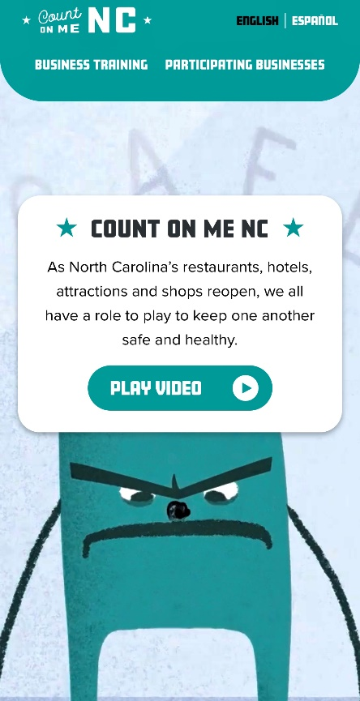

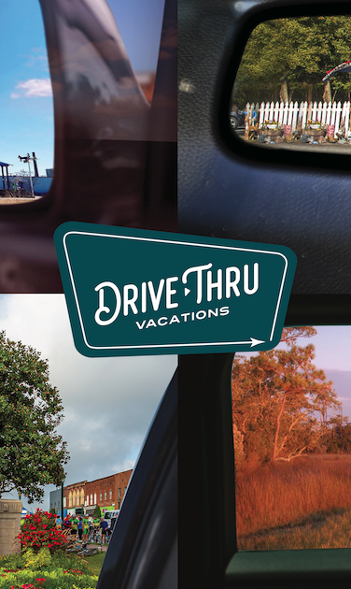


SHIFTS IN MESSAGING & AUDIENCE TARGETING
FIRSTS THAT LAST
COUNT ON ME NC
OUTDOOR NC
Make It Your Nature
DRIVE-THRU VACATIONS
GET BACK TO A BETTER PLACE
16
Notes:
Shifts in Messaging & Audience Targeting
As a state, we typically would only change our messaging strategy every two or three years based on consumer sentiment. However, the pandemic forced us to go through several specific campaigns ranging from public safety to getting people back into a traveling mindset.
We are currently back to our Firsts That Last campaign, but we will launch a new one in 2023 based on the latest research into consumer sentiment and behavior.

Slide 17
FILM LOCATIONS
AIN'T NO MOUNTAIN
Roaring Gap
Elkin
THE ROAD TO NC
North Wilkesboro
THE ROAD TO NC
THE ROAD TO NC
Winston-Salem
Durham
Outer Banks
Great Smoky
Mountains
Chapel Hill
SO FAR
SO FAR
Western NC
WAVERIDER
Mountains-to-Sea Trail
Asheville
Seagrove
Nags Head
SO FAR
MAKING WAVES
Waynesville
Avon
Brevard
Charlotte
SEAGROVE
Ocracoke
Cape
Hatteras
QUEEN OF PISGAH
JACOB’S FIRST MANDOLIN
A HOMECOMING
CENTER CITY!
Emerald Isle
NEXT GENERATION
Notes:
Firsts That Last 2.0 | Film Locations & Themes
What we really love about this campaign is that it depicts content and stories from all across the state – mountains, piedmont and coast.
Rather than having just one ad try to represent the whole state, we’ve been be able to showcase all of our regions and destinations of all sizes.

Slide 18
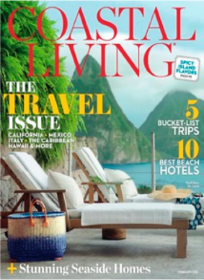







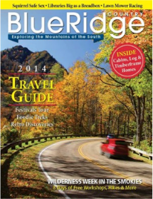
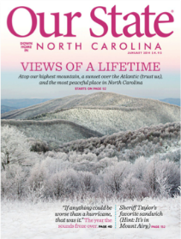

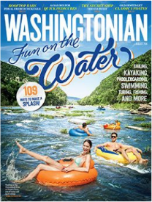


Brand & Co-Op Media Partners: Partners.VisitNC.com
Notes:
Paid Media Partners
Our core paid media budget is invested in digital and print advertising. We have a heavy focus on digital while still offering print co-ops which are very popular with local tourism offices. We emphasize cost-effective reach and frequency strengthens awareness and preference for North Carolina.
Print
We maintain top performers and co-op packages frequently focusing on priority markets of Atlanta, D.C., and others.
Digital Media Partners
Mix of networks, sites and tactics to balance branding and awareness with driving traffic to VisitNC.com and converting that traffic to downstream referrals to our partners’ websites.
Branding & Awareness
We employ high-impact tactics to increase exposure of the overall VisitNC identity and to our current campaign (e.g., rich media, pre-roll video)
Site-Traffic Drivers
We tap vehicles that drive cost-efficient traffic to VisitNC.com in order to enhance overall visitation (e.g., CPC-based media)
Conversion Drivers
And we incorporate strategies that generate qualified traffic to VisitNC.com and convert users based on desired actions such as downstream referrals to our partners’ websites.

Slide 19
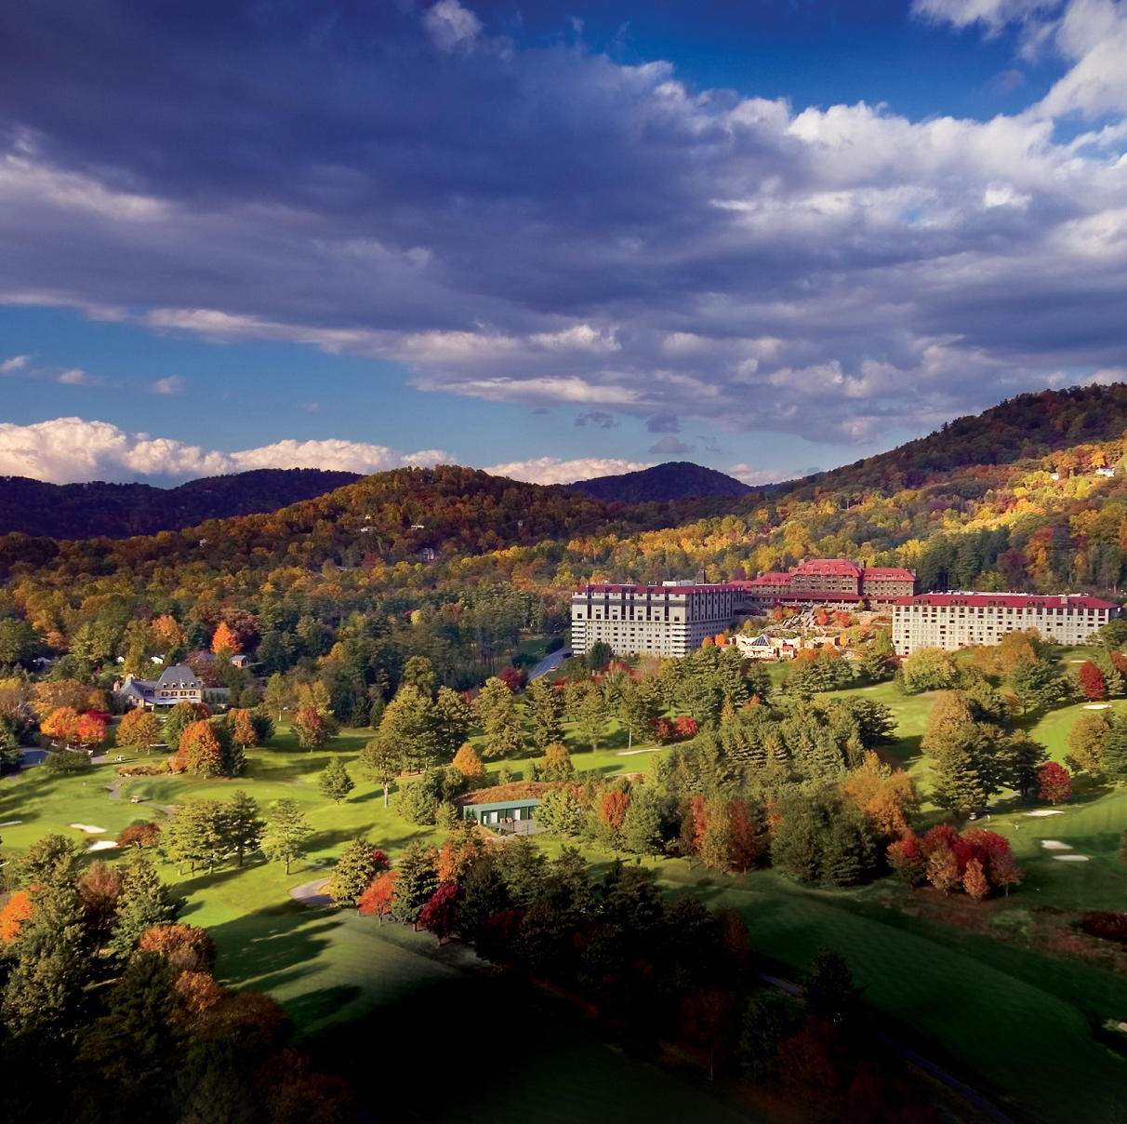
Visit NC Tourism Conference
March 6-8
Asheville, NC
Omni Grove Park Inn
Notes:
Registration is now open for the annual Visit NC Tourism Conference

